Slide 1
Explainable Hate speech Detection
Project evaluation
Dhvanit, 200050035
Margav, 200050072
Sartaj, 200050128
26 Nov 2022

Slide 2
Problem Statement
Given a sentence we need to classify it as either “Normal” , “Hate speech” or “Offensive speech”
We are also given a set of words that the annotator thinks explains his/her rationale behind the label they gave. We use this information while training our model with the help of attention values
Along with a label we also output our own possible rationales when given a new sentence/post with no annotations (to mimic the behaviour of an annotator) using said attention values.

Slide 3
Related works
B. Mathew, P. Saha, S. M. Yimam, C. Biemann, P. Goyal, and A. Mukherjee. HateXplain: A benchmark dataset for explainable hate speech detection. In proceedings of the AAAI Conference on Artificial Intelligence, volume 35, pages 14867–14875, 2021
Zhang, Z.; Robinson, D.; and Tepper, J. A. 2018. Detecting Hate Speech on Twitter Using a Convolution-GRU Based Deep Neural Network. In Proceedings of The Semantic Web - 15th International Conference, 745–760. Heraklion, Crete, Greece: Springer.
Rahul; Vasu Gupta; Vibhu Sehra; Yashaswi Raj Vardhan (Delhi Technological University). Hindi-English Code Mixed Hate Speech Detection using Character Level Embeddings. Published in: 2021 5th ICCMC, Erode, India

Slide 4
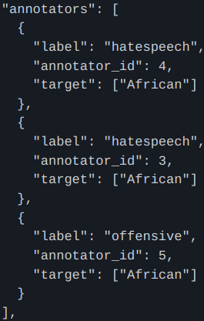
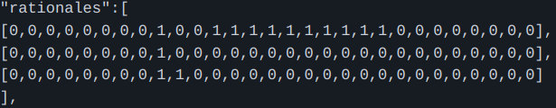
Dataset (s)
Will use the HateXplain Dataset made and provided by the authors of the paper with the same name, primarily sampled from Twitter and Gab.
Each entry in the dataset is a post where one or more annotators provide their choice for a label and their corresponding rationale, target community. This way they attempt to overcome bias of an individual annotator.

Slide 5
Workflow, Technique
We read annotated data: tokens’ list along with rationales, speech-label, and community..
Group sub-parts of a sentence together where consecutive run of words having the same rationale value (0/1) are in a single group/sub-part.
On each sub-part, do Text Preprocessing using the library ekphrasis’s SocialTokenizer()
Now use pretrained bert-base-uncased tokenizer to encode() each sub-part of the sentence (sometimes this will split a single word into more than one integer). Then add tokens corresponding to ‘CLS’ and ‘SEP’.
Since the ground-truth rationales are also accordingly split (repeated 1’s or 0’s that many number of times), we will have to keep track of this splitting behaviour while in prediction phase since we want to rank significant rationales of our prediction according to their attention.
There are three annotators for every sentence. We average (and then take the softmax of) their annotated rationales to get ground-truth rationales.
The ground-truth rationale is the most common label of the three.
Zero-Pad our tokens and rationales to 128 (max_len parameter) dim vectors. Very few sentences are longer than 128. This will be our input to the BertModel
Create a torch DataLoader for random sampling, batching.

Slide 6
Model Architecture
We use the bert-base-uncased model having 12-layer, 768- hidden, 12-heads, 110M parameters.
In order to fine-tune BERT, we add a (dropout layer followed by a) fully connected layer to the output corresponding to the CLS token in the input already passed through a linear layer and tanh activation (to give a pooled output).
To add attention supervision, we try to match the attention values corresponding to the CLS token in the final layer to the ground truth attention, so that when the final weighted representation of CLS is generated, it would give attention to words as per the ground truth attention vector (using cross entropy loss between the attention values and the ground truth attention vector).
For training the model, loss metric is a combination of label-prediction-loss and attention-loss
No performance improvement on validation set was observed on adding more linear layers on the output (although it overfits on the training set quite nicely).

Slide 7
Results and Analysis
 | Precision | Recall | F-score | ROC-AUC
Validation set | 68.27 | 68.77 | 68.38 | 85.41
Testing set | 68.13 | 68.56 | 68.22 | 85.10
Although the performance is relatively good for classification task, rationale predictions are not always very accurate. It still makes sense to include rationales for training as they improve performance of the classification task as we are training by learning 2 tasks simultaneously.
The Paper discusses that only a few words namely ‘retarded, bitch, and white’ for offensive posts and ‘nigger, kike, and moslems’ for HateSpeech posts are present in most (30-47%) of the sentences marked as a rationale by the annotator. So the model is not able to generalise well to predict the rationales as it does not have a large sample space of common enough toxic words.
However our implementation that outputs possible rationales according to descending order of attention values looks correct enough to be included as an output field.

Slide 8
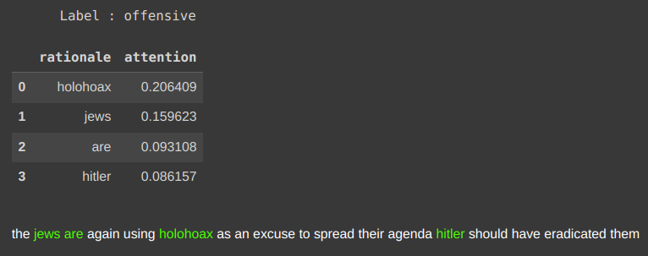
Demo

Slide 9
Evaluation Scheme
1. Attractive and complex problem: 5
2. Clarity in task and in input-output description: 5
3. Dataset effort- collection, annotation: 10
4. Workflow, Architecture, technique: 10
5. Results and analysis: 10
6. Demo working: 20

